Slide 1

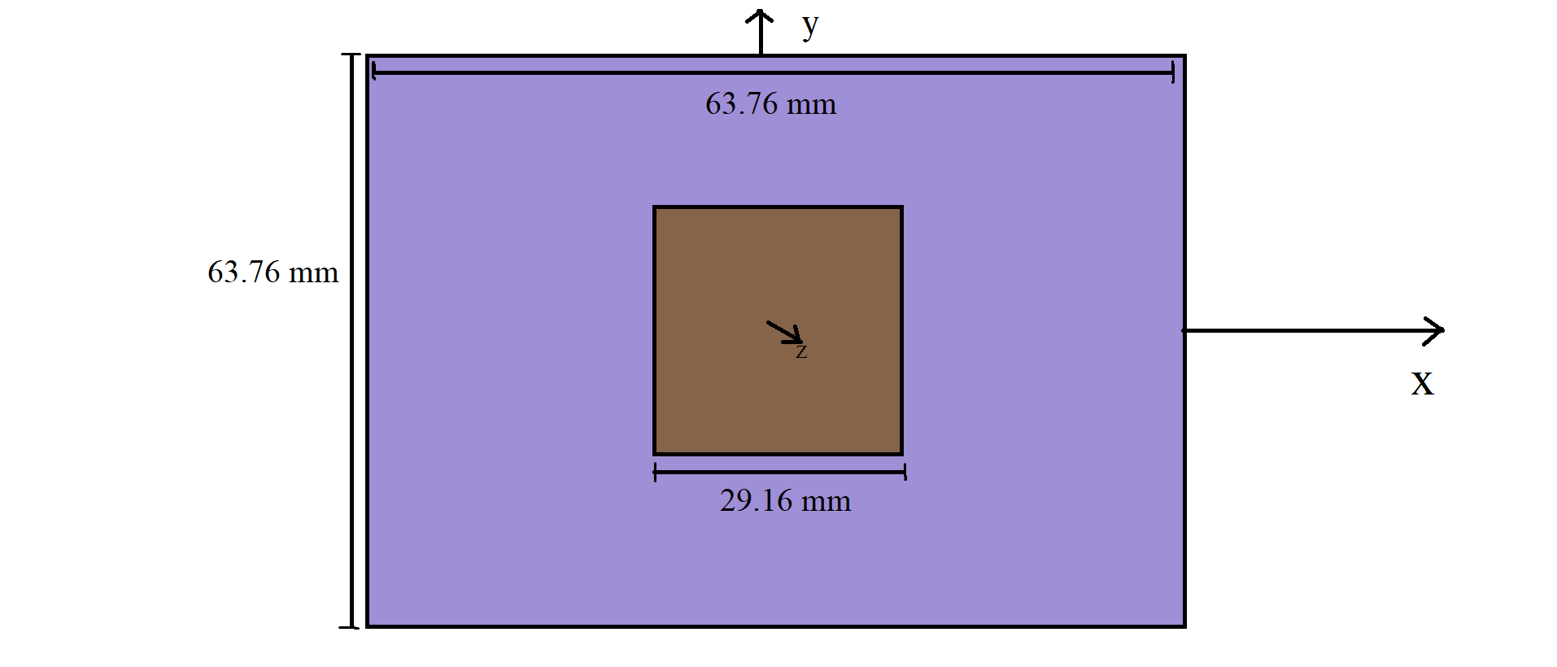
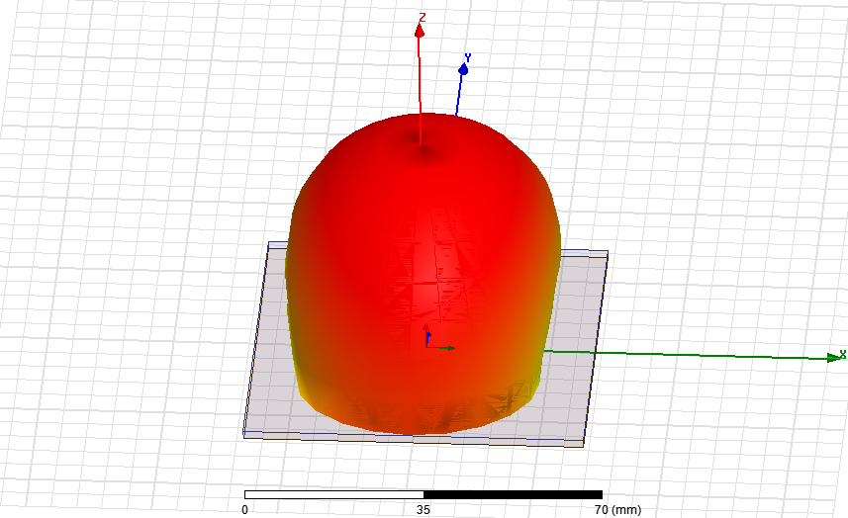

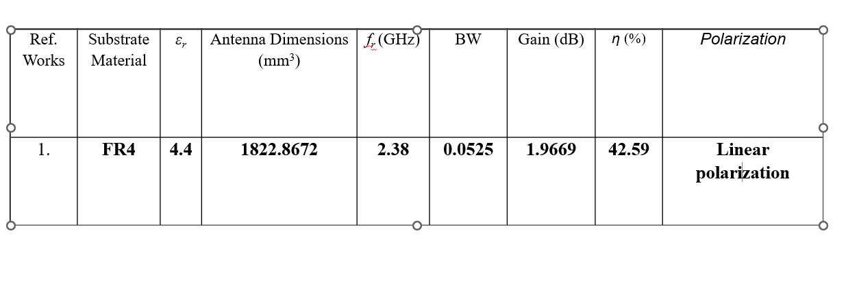
Society For Computer Technology & Research’s
Pune Institute of Computer Technology
Department of Electronics & Telecommunications Engineering
TE Mini project
AY:2022-23
Title: Simulation And Fabrication Of Antenna For MBAN Application
Abstract :-The design simulation of an antenna for MBAN (Medical Body Area Network) application operating at 2.38 GHz with HFSS (High-Frequency Structural Simulator) involves the analysis and optimization of the antenna's performance parameters to ensure reliable communication between medical devices within the body area network. The antenna's design is optimized for the specific frequency range and HFSS protocol to meet the MBAN requirements. In the simulation, various parameters such as return loss, radiation pattern, and impedance matching are analyzed to ensure the antenna's optimal performance. The simulation uses advanced electromagnetic simulation tools, such as HFSS, to design and optimize the antenna, and the results are analyzed to ensure that the antenna meets the required specifications. The optimized design of the antenna with HFSS results in improved wireless communication within the MBAN, providing enhanced reliability and reducing the risk of interference from other wireless devices operating in the same frequency band. The proposed antenna design with HFSS enables the deployment of more effective and reliable healthcare solutions.
Problem Statement :-
Design Simulation And Fabrication Of Antenna For MBAN Application
Objectives of Work :-
To provide reliable and efficient wireless communication between medical sensors and devices attacted to patients body
Antenna should be small in size and low in power consumption
It should be biocompatible.
Methodology
Simulation
Important Results (Tables or Figures or Discussion)
References:
Khilare, Sunny, Rishabh Mhatre, Ganesh Kulkarni, Shahadev Hake, and Pune PICT. “ANTENNA DESIGN FOR WEARABLE MEDICAL DEVICES USING MBAN BAND.”
Zhu, Xiao-Qi, Yong-Xin Guo, and Wen Wu. "Miniaturized dual-band and dual-polarized antenna for MBAN applications." IEEE Transactions on Antennas and Propagation 64, no. 7 (2016): 2805-2814.
T. -W. Koo, J. -G. Yook, Y. -J. Hong, G. Park and K. Shin, "Low profile patch antenna for on-body wireless sensor application in MBAN band," Proceedings of the 2012 IEEE International Symposium on Antennas and Propagation, Chicago, IL, USA, 2012, pp. 1-2, doi: 10.1109/APS.2012.6349020.
Conclusions :- In conclusion, the design simulation of an antenna for MBAN application is an important process that involves several steps, including selecting the operating frequency range, determining the antenna geometry, matching the impedance of the antenna, optimizing the radiation pattern, and evaluating the performance of the antenna using simulation or measurement tools.The design simulation process enables engineers to predict the performance of the antenna and optimize its design to meet the specific requirements of the MBAN application, such as low power consumption, small size, and high data rates.
Om Shinde (32236)
Prathmesh Khose(32240)
Prathmesh Kalamkar(32136)

